Slide 1


NEXT GEN EMPLOYABILITY PROGRAM
CREATING A FUTURE-READY WORKFORCE
Student Name :
Sejal Sandeep Pusate
Student ID :
College Name :
STU6782058aa98561736574346
Trinity Academy of Engineering

Slide 2
CAPSTONE PROJECT SHOWCASE
A Service for Delivering Food (Zomato Clone) with MERN Technology (P3)
Abstract | Problem Statement | Project Overview | Proposed Solution | Technology Used | Modelling & Results | Conclusion | Q&A

Slide 3
Abstract
1
This project develops a Zomato-like food delivery service using the MERN stack, ensuring a seamless user experience.
2
It features user authentication, restaurant listings, and order management with MongoDB Atlas for efficient data storage.
3
The frontend, built with React, provides an intuitive interface, while the backend, powered by Node.js and Express, handles API requests.
4
Secure authentication, real-time updates, and a scalable architecture enhance the platform’s reliability and performance.

Slide 4


Problem Statement
The increasing demand for efficient food delivery services highlights the need for a scalable and user-friendly platform. This project develops a Zomato-like service using the MERN stack, featuring user authentication, restaurant listings, and order management for a seamless experience.

Slide 5

Project Overview
Full-Stack Development: A Zomato-like food delivery platform built using the MERN stack (MongoDB, Express, React, Node.js) for seamless performance.
User Authentication & Management: Secure login and registration system to manage users, restaurants, and admins.
Restaurant Listings & Orders: Users can browse restaurants, place orders, and track their delivery status in real time.
Scalability & Security: Ensures a responsive, secure, and scalable system with MongoDB Atlas for efficient data storage.

Slide 6

Proposed Solution
MERN Stack Implementation: Develop a full-stack food delivery service using MongoDB for data storage, Express.js and Node.js for backend API handling, and React for a responsive frontend.
User & Restaurant Management: Implement secure authentication and role-based access for customers, restaurant owners, and admins to manage orders and listings efficiently.
Real-Time Order Processing: Enable customers to browse restaurants, place orders, and track deliveries with real-time status updates.
Scalability & Security: Utilize MongoDB Atlas for secure and scalable database management while ensuring data encryption and safe transaction processing.
Payment Integration & Notifications: Implement secure online payment options using Stripe/Razorpay and enable email/SMS notifications for order confirmations and updates.

Slide 7
Technology used
MongoDB (Database):
A NoSQL database used for storing user details, restaurant listings, orders, and other data in a flexible JSON-like format.
Express.js (Backend Framework):
A lightweight Node.js framework used to build RESTful APIs for handling authentication, orders, and restaurant management.
React.js (Frontend Framework):
A JavaScript library for building a dynamic and responsive user interface.
Node.js (Runtime Environment):
Runs JavaScript on the server-side, enabling backend API development.
JWT (JSON Web Token) for Authentication:
Ensures secure login and authentication for users, restaurant owners, and admins.

Slide 8
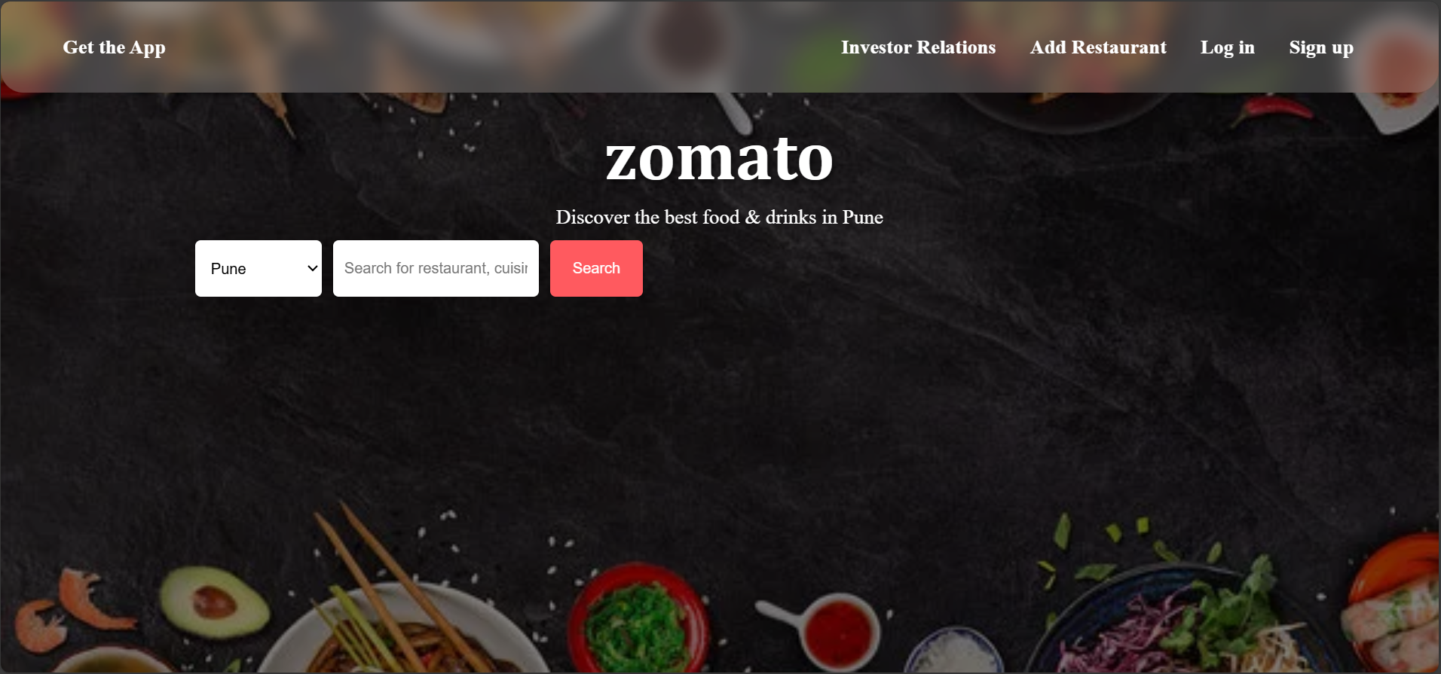
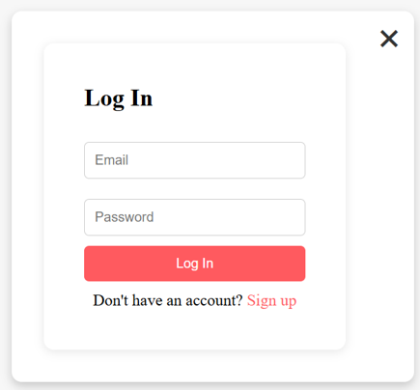
Modelling & Result
1.
2.
This is the homepage of the Zomato Clone project, featuring a search interface for discovering restaurants in a selected city.
This is the login page of the Zomato Clone project, allowing users to access their accounts.

Slide 9
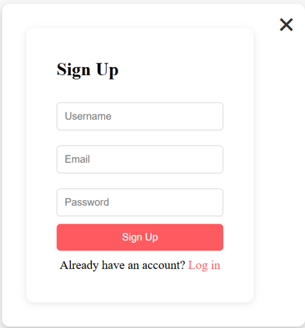
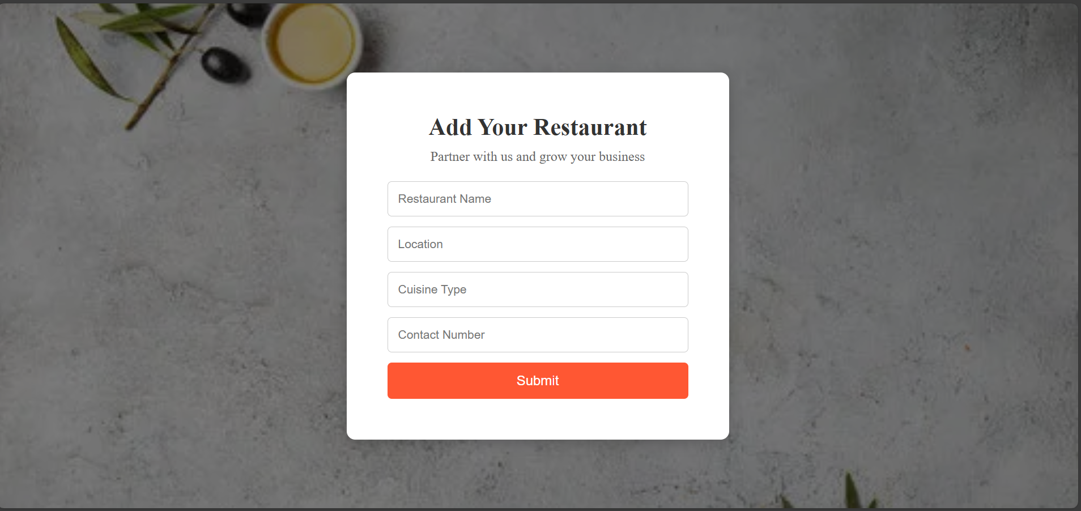
Modelling & Result
3.
4.
This is the sign-up page of the Zomato Clone project, where new users can create an account.
This is the "Add Your Restaurant" page in the Zomato Clone project, allowing restaurant owners to register their business.

Slide 10
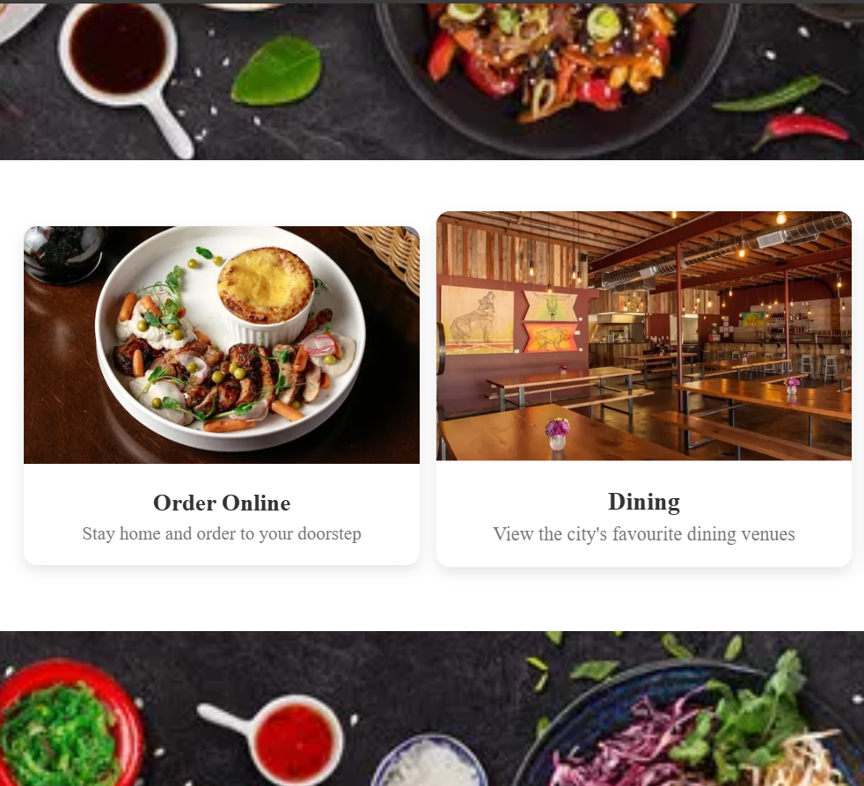
Modelling & Result
5.
This section of the Zomato Clone project provides users with two primary options:
Order Online: Users can browse and order food online for doorstep delivery.
Dining: Users can explore popular dining venues in their city for an in-person experience.

Slide 11

Conclusion
The development of "A Service for Delivering Food (Zomato Clone) with MERN Technology (P3)" successfully demonstrates how modern web technologies can be leveraged to create a seamless and efficient food delivery platform. By utilizing the MERN stack (MongoDB, Express.js, React.js, and Node.js), the project ensures a dynamic, scalable, and user-friendly experience for customers, restaurant owners, and administrators.

Slide 12
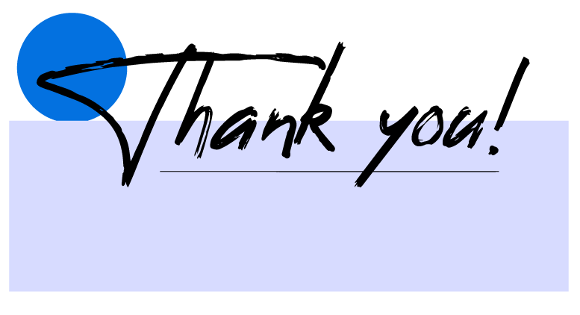

Notes:
Thank You !!

